Slide 1
Lightning Talk: Prototyping
Hybrid Relightable 3D Gaussian Rendering (sdmay25-40)
Kyle Kohl, Brian Xicon, Ethan Gasner, Luke Broglio, Jackson Vanderheyden
Advisor: Simanta Mitra
| sdmay25-40
| 11/12/24

Slide 2
Project Overview
Our project is a novel view synthesis system that uses 3D Gaussian splats with a raytracer that allows for real time dynamic lighting and the incorporation of traditional polygon meshes.
Use a Machine Learning model to extract material properties from videos to allow for dynamic lighting.
Create a Unity package consisting of our renderer
| sdmay25-40
| 11/12/24
Hybrid Relightable 3D Gaussian Raytracer | 1

Slide 3
Project Overview
Novel View Synthesis
Novel View Synthesis: A technique used to generate images from any perspective.
Tradi
tional Methods: Includes NeRFS (Neural Radiance Fields) and photogrammetry.
Drawbacks of Traditional Methods:
Expensive.
Produce subpar results.
New Solution: 3D Gaussian Splatting.
Faster than traditional methods.
Provides higher quality renders than NeRFS.
Limitation of 3D Gaussian Splatting:
Not relightable (lighting is static from the original video).
Proposed Solution for Limitation:
Use AI to extract the model's lighting and material properties.
| sdmay25-40
| 11/12/24
Hybrid Relightable 3D Gaussian Raytracer | 2

Slide 4
Project Overview
3D Gaussian
To be able to create models we use 3D Gaussians.
Think of a 3D Gaussian as a blurry dot in space.
By combining and reshaping multiple 3D Gaussians we can build 3D objects.
3D Gaussians can have multiple different variables including position, color, opacity, and covariance.
| sdmay25-40
| 11/12/24
Hybrid Relightable 3D Gaussian Raytracer | 3

Slide 5
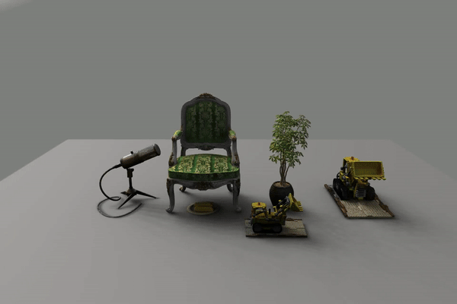
Project Overview
Relightability
Relightability is the technique of removing the original lighting from a model to instead insert our own.
Allows for us to change the lighting in a few different ways like changing the intensity and position of the lights.
The 3D Gaussians are able to be relightable because of the variables of the Gaussians like color, and roughness that act as material properties.
Source: https://nju-3dv.github.io/projects/Relightable3DGaussian/
| sdmay25-40
| 11/12/24
Hybrid Relightable 3D Gaussian Raytracer | 4

Slide 6
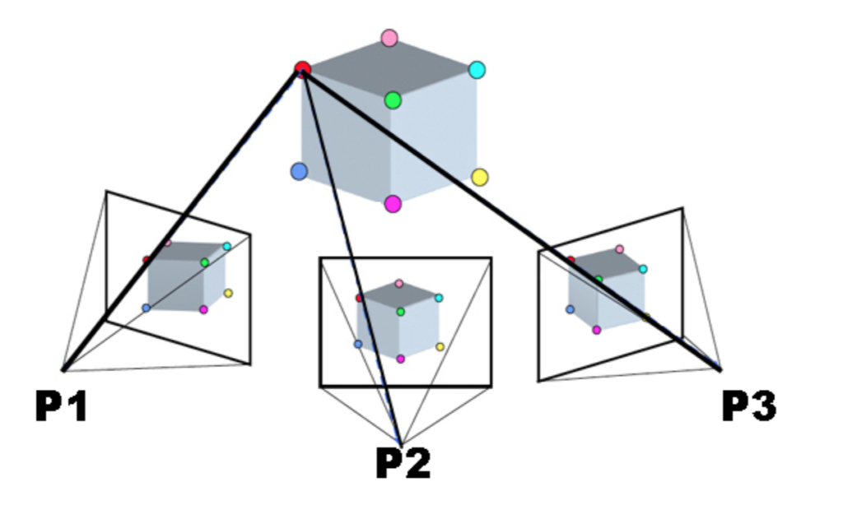
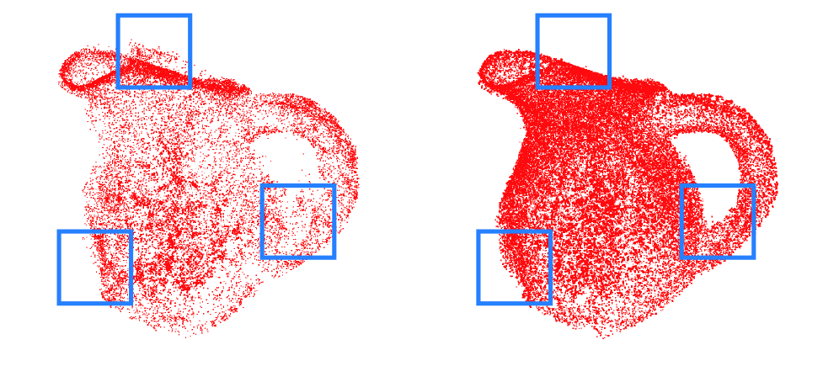
Project Overview
ML Applications
Structure from Motion (SfM)
reconstructs 3D structures from multiple 2D images.
Gaussian Point Optimizer
position, opacity, covariance, color.
Material predictor
reflectivity, roughness, and transparency.
| sdmay25-40
| 11/12/24
Hybrid Relightable 3D Gaussian Raytracer | 5

Slide 7
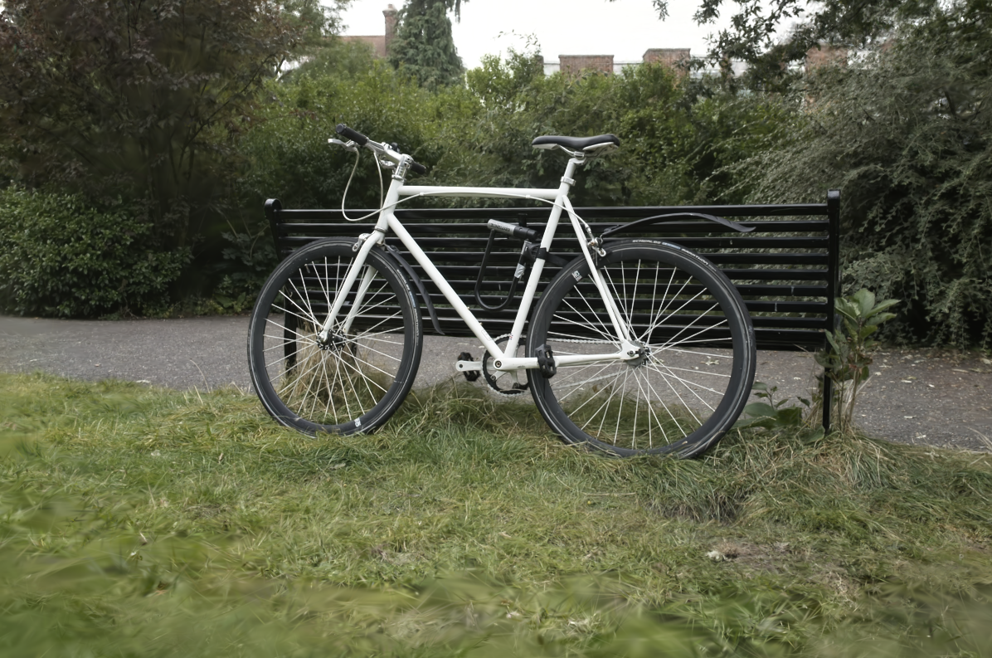
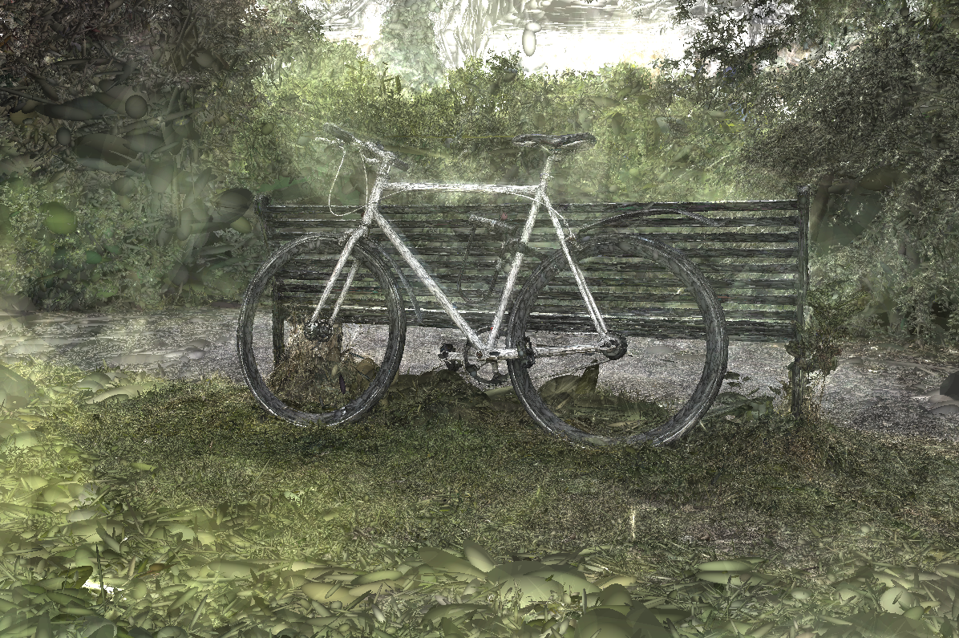
Source: https://huggingface.co/blog/gaussian-splatting
| sdmay25-40
| 11/12/24
Hybrid Relightable 3D Gaussian Raytracer | 6

Slide 8
3D Gaussian Parser Prototype
What is the purpose of this prototype?
This demo shows what Gaussians look like when rendered as images.
Also helps anyone unfamiliar with Gaussian splatting understand what we are doing
The tools used to load and pass along these Gaussians will be used to pass Gaussian data to the Raytracer.
| sdmay25-40
| 11/12/24
Hybrid Relightable 3D Gaussian Raytracer | 7

Slide 9
3D Gaussian Parser Prototype
| sdmay25-40
| 11/12/24
Hybrid Relightable 3D Gaussian Raytracer | 8

Slide 10
3D Gaussian Parser Prototype
| sdmay25-40
| 11/12/24
Hybrid Relightable 3D Gaussian Raytracer | 9

Slide 11
3D Gaussian Parser Prototype
| sdmay25-40
| 11/12/24
Hybrid Relightable 3D Gaussian Raytracer | 10

Slide 12
3D Gaussian Parser Prototype Reflection
Gave us practice / an example of implementing the equation to determine pixel color from Gaussians
Debugging issues helped practice methods for debugging code on the GPU
Give us a visual we can use to help explain and demonstrate how 3D Gaussians can be used to determine colors and make images.
| sdmay25-40
| 11/12/24
Hybrid Relightable 3D Gaussian Raytracer | 11

Slide 13
Triangle Mesh Ray Tracer Prototype
What is the purpose of this prototype?
Build out ray tracer architecture
Integrate rendering solution into Unity’s framework
Support triangle meshes and basic materials
| sdmay25-40
| 11/12/24
Hybrid Relightable 3D Gaussian Raytracer | 12

Slide 14
Triangle Mesh Ray Tracer Prototype
| sdmay25-40
| 11/12/24
Hybrid Relightable 3D Gaussian Raytracer | 13

Slide 15
Triangle Mesh Ray Tracer Prototype Reflection
Created a foundation that the hybrid ray tracer will build off of
Learned how to serialized scene data
Developing, debugging, and testing compute shaders
| sdmay25-40
| 11/12/24
Hybrid Relightable 3D Gaussian Raytracer | 14

Slide 16
Implications and Next Steps
Render 3D Gaussians with the ray tracer
Render triangle meshes with physically based lighting calculations
Improve performance with Bounding Volume Hierarchies (BVHs)
Support composite scenes with 3D Gaussian and triangle mesh models
| sdmay25-40
| 11/12/24
Hybrid Relightable 3D Gaussian Raytracer | 15

Slide 17
Questions?
| sdmay25-40
| 11/12/24
Hybrid Relightable 3D Gaussian Raytracer | 16

